Slide 1
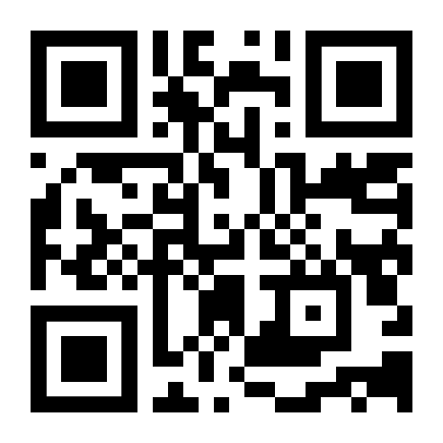
Sales Masterclass
June 2024
Rennee Perri
Senior Sales Executive

Slide 2
Agenda
What is your role?
Want vs need
Transactional selling & solution selling
Building lead & sales pipelines
Customer touchpoints
Customer retention
Referral business
Pricing (yourself out of deals)
Expos and events
Technology – What are you using? FG Business Management

Slide 3
What is your role?
Rennee Perri – Sales Executive & Business Owner

Slide 5
Background
2020 Sports Nutrition, Nutritional Healing
2018 Saba Sales Training – Completed in London
2018 The Brevet Group – Sales Methodology – Completed in Montreal Canada
2016 SalesITV Coaching System for Sales Managers
2015 Sandler Sales Training System – Completed in Canada - Refresher
2014 Sandler Sales Training System – Completed in Canada
2012 Sandler Sales Training – Completed in Boston
2011 Huthwaite Spin Selling – Completed in Sydney
2011 MS CCIE
2011 Microsoft LAR Boot-Camp
2010 Lead generation for new security Citrix
2010 CCSP 2011 for Server Virtualisation
2010 CCSP for Virtual Computing
2010 CCSP 2011 for Desktop Virtualisation
2010 Symantec Protection Suite SBE – Advanced Enterprise & Business Addition
2010 Symantec Back up Exec System Recovery
2001 Associate Marketing Diploma
2000 Rogen BDM Certificate
2000 Rogen Sales Skills Certificate
1997 Sales Skills Training ‐ Anixter Certificate
1996 Marketing Certificate – Completed in Sydney
1995 Tele skills Workshop ‐ Levita
Certifications:
Genesys Sales Training
Genesys Demo Delivery Training
Performance Management - 1, 2 &3
Succession Planning
Learning & Development - 1, 2 & 3
1:1 Meeting
360 Review
Talent Acquisition
Myers Briggs - Personality (I am an ENFP )
Leadership Skills
Employee Life Cycle

Slide 6
Background

Slide 7
MENTORS - Do you need them?

Slide 8
vs
Want
Need

Slide 9
Sales strategies
Transactional selling
Solution selling
Consultative selling

Slide 10
Transactional selling
Have a clear and quickly illustrated value proposition
Optimise the buying process
Offer tangible differentiators
Train your team for speed and efficiency
Establish trust quickly
Flexibility is key
Follow-up (but not too much)
Consistent branding
Pricing needs to be on point

Slide 11
Solution selling methodology
1
2
3
4
5
Understand
your products
or services
Ask the right
questions
Qualify your
prospects
Craft a potential
solution
Close the deal

Slide 12
Consultative selling
1
2
3
4
5
Connect with
the customer
Understand customer needs
Address customer needs
Close the sale
Establish sustainable customer relationship

Slide 13
Building a lead pipeline
& a sales pipeline

Slide 15
Social media
In-person
events,
meetings,
discussions
Public
relations
Customer
touchpoints
Advertising
in digital and electronic media
Digital
marketing
collaterals
Telephonic
and email
communication
Print
Media
OOH
OOT

Slide 16
5 strategies to improve
customer retention
Engage with Customers
Reduce fricton in the purchase process
Improve customer support
Create a community
Start a loyalty program
Review at your marketing channels and identify the best ways to engage with clients, whether it's social media, email, online events, or something else.
The fewer obstacles or challenges clients
face when purchasing your product or service,
the better - reduce page load times and simplify checkout procedures.
Offer multiple ways for customers to reach you. This can include live chat on your website, a dedicated phone number, email, social media, and a comprehensive FAQ page online.
Having exclusive membership programs or forums where your company representatives and customers can interact with each other will help generate more brand loyalty and buzz.
Motivate existing customers to make additional purchases and at a higher frequency with loyalty programs, using rewards that existing customers would find valuable, like free products or significant discounts.

Slide 17
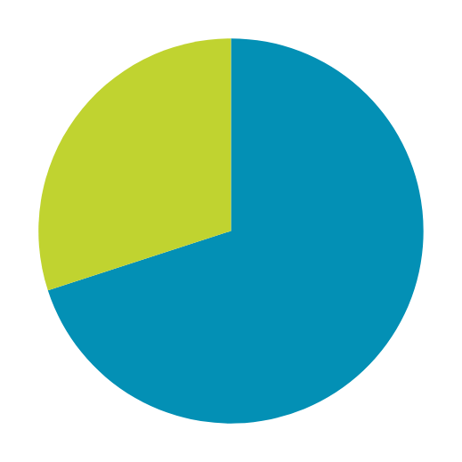
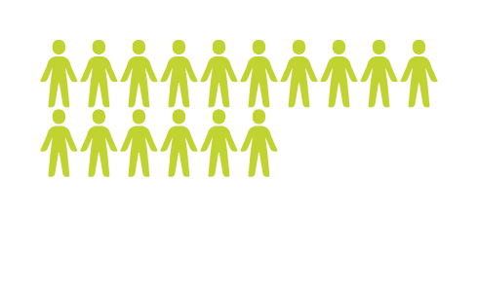
Referral business
In a survey of over 3,000 business people,
more than 50%
of the respondents said they got...
referral business closes and converts
70%
of the time
the majority
of their customers through referrals

Slide 18
Cost-plus pricing
Competition-oriented
pricing
Marginal
cost pricing
Pricing
strategies
Psychological pricing
Target ROI pricing
Demand-based
pricing
Experience curve
pricing

Slide 19
Expos and events

Slide 20
Thank you
1300 850 890 | hello@flexigrow.com

